Slide 1
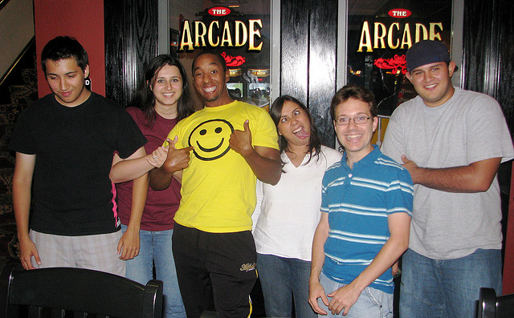

Adolescent Development
[Professor Name]
[Class and Section Number]
Notes:
Class Recommendations: This lecture is designed for one long-class period (75-90 minutes), but it could be broken up into two shorter class periods (50-60 minutes).
Overview: Adolescence is a period that begins with puberty and ends with the transition to adulthood (approximately ages 10–20). Physical changes associated with puberty are triggered by hormones. Cognitive changes include improvements in complex and abstract thought, as well as development that happens at different rates in distinct parts of the brain and increases adolescents’ propensity for risky behavior because increases in sensation-seeking and reward motivation precede increases in cognitive control. Adolescents’ relationships with parents go through a period of redefinition in which adolescents become more autonomous, and aspects of parenting, such as distal monitoring and psychological control, become more salient. Peer relationships are important sources of support and companionship during adolescence yet can also promote problem behaviors. Same-sex peer groups evolve into mixed-sex peer groups, and adolescents’ romantic relationships tend to emerge from these groups. Identity formation occurs as adolescents explore and commit to different roles and ideological positions. Nationality, gender, ethnicity, socioeconomic status, religious background, sexual orientation, and genetic factors shape how adolescents behave and how others respond to them, and are sources of diversity in adolescence.
Additional Instructions: Students will begin with a warm-up to get them reflecting metacognitively upon their own learning techniques. Next, students will learn about learner characteristics and encoding strategies that can affect learning. Students will be asked to think about the mechanisms behind certain successful techniques and their implications for learning. Finally, general principles of learning are covered, with emphasis on the benefits of spacing and forgetting.
Technical Note: These slides may contain simple click animation so that you can focus students’ attention on a particular question, a selection of text, or an image and not have them be distracted by reading ahead. You can either preview the sequence of animation by going through the slides in slideshow view, visiting the animations tab, or reviewing the slide notes. In the notes you will see a cue - (Click) – that corresponds to each animation.
You may also find hyperlinks to outside videos at various places in the slides. These hyperlinks are embedded in text and indicated by color and in the notes section.

Slide 2
Learning Objectives
Describe major features of physical, cognitive, and social development during adolescence.
Understand why adolescence is a period of heightened risk taking.
Be able to explain sources of diversity in adolescent development.
Notes:
Purpose: This slide outlines the learning objectives of the module.

Slide 3

Warm Up: Adolescence Defined
Reflect on your own adolescence
Are you an adult? Adolescent? In between?
“Adolescence” is getting longer…
Emerging Adolescence
Notes:
Purpose: This slides outlines a warm-up activity.
(Click) Reflect on your own adolescence
To begin the class, ask students to reflect on their own adolescence, how they generally felt and what their daily activities were like.
(Click) Are you an adult, an adolescent, or somewhere in between?
Then, ask students to reflect on whether they feel that they are an adult, an adolescent, or somewhere in between? Ask them why they feel this way, and what developmental achievements they associate with adulthood that they may not have achieved yet.
(Click) “Adolescence” is getting longer…
Use this brief discussion as a jumping off point to explain that adolescence has traditionally been seen as starting at puberty and ending at adulthood (roughly ages 10-20). However, adolescence has been lengthening over historical time, and today puberty typically begins earlier and adulthood begins later than in the past.
(Click) Emerging adolescence
Explain that this prolonging of adolescence has even prompted the coining of a new developmental period called emerging adulthood, which takes place from approximately ages 18-29.

Slide 4
Overview
Physical Changes
Puberty
Cognitive Changes
Social Changes
Behavioral and Psychological Adjustment
Notes:
Purpose: The purpose of this slide is to provide students with an overview of the material that will be covered during the lecture.

Slide 5
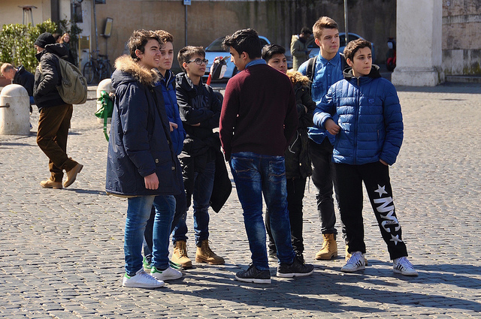
Physical Changes
Puberty and hormone changes
Growth spurt, pubic hair, skin changes
Boys – facial hair, voice deepens
Girls – breast development, menstruation
Notes:
Purpose: The purpose of this slide is to teach students about physical changes that occur in adolescence.
(Click): Puberty and hormones
Puberty marks the onset of adolescence, driven by changes in hormones (increased testosterone for boys, increased estrogen for girls).
(Click): Growth spurt, pubic hair, skin changes
Changes include growth spurt, new pubic and underarm hair, and skin changes, such as pimples.
(Click): Boys – facial hair, voice deepens
Boys grow facial hair and the voice deepens.
(Click): Girls – breast development, menstruation
Girls experience breast development and begin menstruating, which is also known as menarche.

Slide 6
Overview
Physical Changes
Cognitive Changes
Changes in Brain Functioning
Changes in Brain Structure
Social Changes
Behavioral and Psychological Adjustment
Notes:
Purpose: The purpose of this slide is to provide students with an overview of the material that will be covered during the lecture.

Slide 7
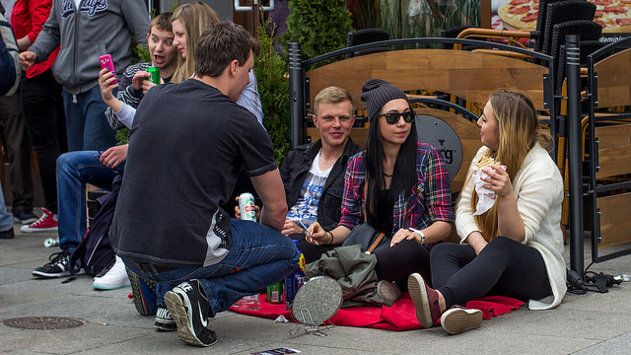
Cognitive Changes
Changes in Brain Functioning
Thinking is more abstract and complex
Attention
Memory
Processing speed
Metacognition
Notes:
The purpose of this slide is to teach students about cognitive changes that occur during adolescence, beginning with changes in brain functioning.
(Click): Changes in Brain Functioning
Major changes in brain functioning occur during adolescence.
(Click): Thinking is more abstract & complex
Thinking becomes less concrete and “black and white,” and more abstract and complex, facilitated by…
(Click): Attention
Enhanced attention…
(Click): Memory
Improved memory…
(Click): Processing speed
Faster processing speed…
(Click): Metacognition
And improvements in metacognition.

Slide 8

Changes in Brain Structure
Dopamine system
Prefrontal cortex
“A powerful engine with no brakes!”
Notes:
Purpose: The purpose of this slide is to teach students about changes in brain structure that occurs during adolescence.
(Click): Dopamine system
Changes in the brain’s dopamine system increase reward motivation and sensation-seeking, which leads to heightened risk-taking (physical risks, use of alcohol and drugs).
(Click): Prefrontal Cortex
The prefrontal cortex develops late in adolescence, increasing cognitive control and self-regulation.
(Click): “A powerful engine with no brakes!”
However, because the dopaminergic system changes occur earlier, there is a window of time when it is as if adolescents have a “powerful engine but no braking system” (Steinberg, 2008).
Reference:
Steinberg, L. (2008). A social neuroscience perspective on adolescent risk-taking. Developmental Review, 28, 78–106.

Slide 9
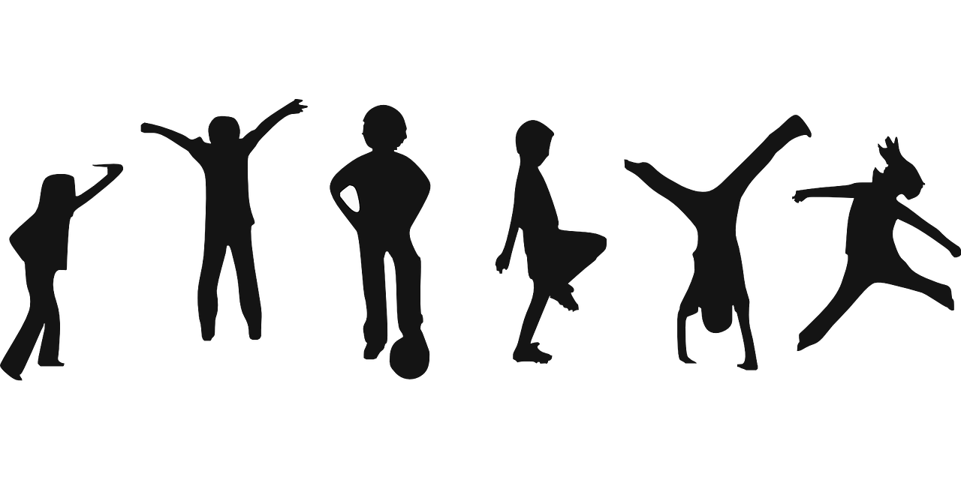
Activity: Formal Operations
Observe and compare the behavior of a younger child and an adolescent completing two Piagetian “formal operations” tasks.
Notes:
Formal Operations in Adolescence Activity: The purpose of this activity is to demonstrate the development of formal operations and what they entail.
Time: 12-14 minutes
Materials: Formal Operations video (see PowerPoint slides).
Directions:
Observe and compare the behavior of a younger child and an adolescent completing two Piagetian “formal operations” tasks.
Watch video: https://www.youtube.com/watch?v=zjJdcXA1KH8
Introduce a “Think-Pair-Share” activity
Discuss the following questions with a partner (5 minutes)
What differences did you notice between the two examples? (child vs. adolescent).
How do these examples illustrate the abstract and complex thinking characteristic of adolescents?
What new things might this more advanced type of thinking allow an adolescent to do?
Instructors Note: Please go to the next slide → after explaining the rules below, it displays these questions so students can keep track of them and don’t have to memorize them.
Tell the class that when discussing the videos with their partner, they should:
Take turns, and try to have an equal speaking time
Listen carefully and ask clarifying questions of one another
You should be able to explain your partner’s thinking, as well as your own
Feel free to write notes as you discuss with your partner
Class Discussion and Sharing (5 minutes)
Call on various pairs of students to share what they have talked about.

Slide 10
Activity: Formal Operations
Discuss the following questions with a partner (5 minutes)
What differences did you notice between the two examples? (child vs. adolescent).
How do these examples illustrate the abstract and complex thinking characteristic of adolescents?
What new things might this more advanced type of thinking allow an adolescent to do?
Notes:
Activity #1 - Formal Operations in Adolescence (continued)
Introduce a “Think-Pair-Share” activity
Tell the class that when discussing the videos with their partner, they should:
Take turns, and try to have an equal speaking time.
Listen carefully and ask clarifying questions of one another.
You should be able to explain your partner’s thinking, as well as your own.
Feel free to write notes as you discuss with your partner.
(Click) Discuss the following questions with a partner (5 minutes)
(Click) 1. What differences did you notice between the two examples? (child vs. adolescent).
2. How do these examples illustrate the abstract and complex thinking characteristic of adolescents?
3. What new things might this more advanced type of thinking allow an adolescent to do?
Class Discussion and Sharing (5 minutes)
“Cold call” various pairs of students to share what they have talked about

Slide 11
Overview
Physical Changes
Cognitive Changes
Social Changes
Parents
Peers
Romantic Relationships
Behavioral and Psychological Adjustment
Notes:
Purpose: The purpose of this slide is to provide students with an overview of the material that will be covered during the lecture.

Slide 12
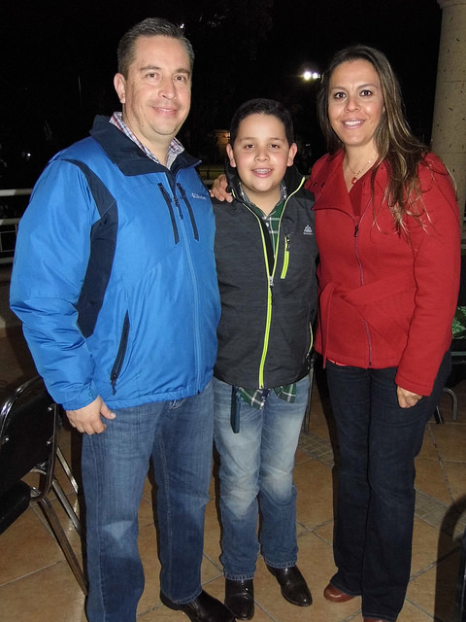
Social Changes
Relationships with parents
Renegotiation of relationships
Independence
Autonomy
Distal monitoring by parents
Psychological control
Notes:
Purpose: This slide is meant to teach students about changes in social relationships with parents during adolescence.
(Click) Relationships with parents
(Click) Renegotiation of relationships
Independence
Autonomy
Adolescence involves a renegotiation of parent-child relationships, as adolescents strive for greater independence and autonomy.
(Click) Distal monitoring
Distal monitoring by parents (e.g. setting rules, getting to know a child’s friends, listening to what an adolescent discloses) becomes more important as adolescents spend more time with peers and away from parents.
(Click) Psychological control
Psychological control involves manipulation and intrusion into adolescent’s cognitive and emotional worlds by invalidating adolescents’ feelings and pressuring them to think in certain ways. This is linked to more problematic adjustment during adolescence.

Slide 13
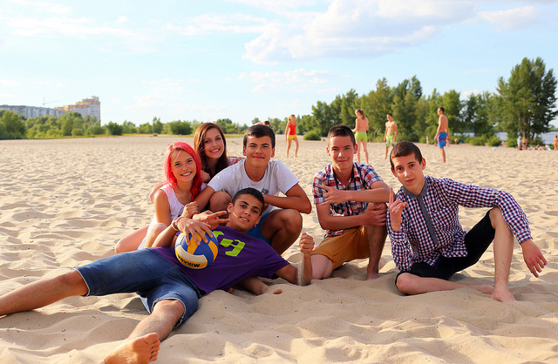
Relationships with Peers
Exchanges of thoughts/ feelings
Mixed sex peer groups
Groups of similar peers
Riskier behavior in groups
Peer social support
Emergence of crowds
Notes:
Purpose: This slide is meant to teach students about changes in social relationships with peers during adolescence.
(Click) Exchanges of thoughts and feelings
While children’s friendships focus on shared activities, adolescent friendships involve intimate exchanges of thoughts and feelings.
(Click) Mixed sex peer groups
Peer groups become mixed-sex during adolescence.
(Click) Groups of similar peers
Adolescent peer groups tend to be similar in attitudes and behavior. This may be because similar adolescents “flock together” and because the adolescent group itself shapes the psychology of its members.
(Click) Riskier behavior in groups
Adolescents tend to engage in riskier behavior in groups than they would alone or with parents, and deviant peer contagion is a process by which problem behaviors are reinforced by approval within the peer group.
(Click) Peer social support
Peers also provide crucial social support and companionship during adolescence, and positive peer relationships relate to happiness and adjustment during this period.
(Click) Emergence of crowds (jocks, nerds, theater people)
Crowds (distinct from cliques or friendships) emerge during adolescence, and are characterized more by shared reputations or prototypic identities (e.g. jocks, brains) than actual social interactions between crowd members.

Slide 14

Romantic Relationships
First emerge in adolescence
Short-lived but meaningful
Contribute to identity development
Policy makers’ focus on teen pregnancy & contraception
Notes:
Purpose: This slide is meant to teach students about the emergence of romantic relationships with peers during adolescence.
(Click) First emerge in adolescence
Romantic relationships typically first emerge in adolescence, in the context of new mixed-sex peer groups.
(Click) Short-lived but meaningful
These relationships are generally short-lived, but command a lot of adolescents’ time and can influence both positive and negative emotions.
(Click) Contribute to identity development
Romantic relationships contribute to adolescent identity development and emerging sexuality and sexual identity (e.g. straight, lesbian, gay, bisexual, transgender, queer, etc.)
(Click) Policy makers’ focus on teen pregnancy & contraception
Parents, policymakers, and researchers have often viewed adolescent sexuality in narrow terms of concern about teen pregnancy and contraception.

Slide 15

CAT: The Muddiest Point
What was the muddiest point in today’s class?
Write down what concept you are still struggling to understand.
Notes:
Classroom Assessment Technique (CAT): The Muddiest Point
Ask students to write down the “muddiest point” – that is any concept they are still struggling to understand of any questions they still may have about the material. With remaining class time, ask students to share their muddiest point and provide additional review on these points.
If you do not conclude with this Classroom Assessment Technique (CAT), it would helpful to use another CAT. It could be in the form of a:
Muddy point
One-minute paper
Background knowledge
What’s the Principle?
Defining features Matrix:
For more information on CATs click here: http://cft.vanderbilt.edu/guides-sub-pages/cats/
If you are doing this lesson in two class sessions, THIS IS THE END OF CLASS 1.
Review answers after class and use students’ responses to help guide your review at the start of day 2.

Slide 16

Review of Muddy Concepts
Notes:
Purpose: This slide prompts a review of difficult or “muddy concepts from the previous class.
Review content from the previous lesson, based on responses to the one-minute paper CAT.
After reviewing, discuss an overview of todays lesson. Explain that in today’s lesson you are going to talk next about the behavioral and psychological adjustment of adolscents.

Slide 17
Overview
Physical Changes
Cognitive Changes
Social Changes
Behavioral and Psychological Adjustment
Identity Formation
Aggression and anti-social behavior
Anxiety and Depression
Academic achievement
Diversity
Notes:
Purpose: The purpose of this slide is to provide students with an overview of the material that will be covered during the lecture.

Slide 18

Behavioral and Psychological Adjustment
Identity Formation
Marcia’s 4 identity statuses
Foreclosure
Identity diffusion
Moratorium
Identity achievement
Ethnic identity development
Notes:
Purpose: The purpose of this slide is to teach students about identity formation in adolescence.
(Click): Identity Formation
Erikson viewed identity formation as the crucial developmental task of adolescence.
(Click): Marcia’s 4 identity statuses
Marcia described potential exploration and commitment to ideologies and roles that could lead to 4 different identity statuses.
(Click): Marcia’s 4 identity statuses
(Click): Foreclosure
An individual commits to an identity without exploring options.
(Click): Identity diffusion
Identity diffusion: when adolescents neither explore nor commit to an identity.
(Click): Moratorium
Adolescents are actively exploring but have not made commitments.
(Click): Identity achievement
Adolescents explore options and make commitments.
(Click): Ethnic identity development
A similar model of ethnic identity development has also been proposed.

Slide 19

Aggression and Anti-social Behavior
Early starters
Late starters
Greater risk for early starters
“Maturity gap”
Notes:
Purpose: The purpose of this slide is to teach students about aggression and anti-social behavior in adolescence.
(Click): Early starters
Early starters: aggressive and anti-social behavior begins in childhood.
(Click): Late starters
Late starters: aggressive and anti-social behavior begins in adolescence.
Click): Greater risk for early starters
Early starters are theorized to be at greater risk for continued anti-social behavior into adulthood.
Click): “Maturity Gap”
Anti-social behavior limited to adolescence is thought to result from a “maturity gap” between dependence on parents and desire to establish freedom from adult constraints.

Slide 20

Anxiety and Depression
Females have higher rates in adolescence
Suicide
Interpersonal factors
Co-rumination
Effect on relationships
Notes:
Purpose: The purpose of this slide is to teach students about anxiety and depression in adolescence.
(Click): Females have higher rates in adolescence
Starting in adolescence, females experience higher rates of anxiety and depression than males.
(Click): Suicide
Suicide is one of the leading causes of death in adolescence.
(Click): Interpersonal factors
Interpersonal factors contributing to depression and anxiety are family adversity, abuse, and parental psychopathology.
(Click): Co-rumination
Depressed youth tend to select other depressed youth as friends to co-ruminate, exacerbating negative affect and stress.
(Click): Effect on relationships
Depression and anxiety negatively affect relationships, thus creating a vicious circle.

Slide 21
Activity: The Teen Brain and Student Jury
Do examples of risky teen behaviors come to mind from your middle and high school days?
Did you observe or engage in behaviors that, on reflection, seem kind of dumb?
Why do you think adolescents are more risk-prone?
Are teens worse at assessing long-term risks like tobacco addiction, or the pos­sibility of pregnancy, or the dangers of speeding?
1. A not-yet mature prefrontal cortex
2. Greater peer influence
Notes:
Purpose: This slide is used in carrying out an activity to help students think about policy implications of adolescent brain development.
Activity: Submitting the Teen Brain to a Student Jury
Time: 25 minutes
Start by asking students the following questions:
(Click) Do examples of risky teen behaviors come to mind from your middle and high school days?
(Click) Did you observe or engage in behaviors that, on reflection, seem kind of dumb?
(Click) Why do you think adolescents are more risk-prone?
(Click) Are teens worse at assessing long-term risks like tobacco addiction, or the pos­sibility of pregnancy, or the dangers of speeding?
During discussion, you can point out that, actually, teen comprehension of risk tends to be quite accurate. Adolescent risk-taking instead appears to stem from two factors:
(Click) 1. A not-yet mature prefrontal cortex
A less than fully mature prefrontal cortex leads to poorer planning and impulse control.
(Click) 2. Greater peer influence
Teens, more than children and adults, are herd animals. Teens tend to commit delinquent acts in groups, while adults more often offend act alone. In laboratory driving simulations, teens also — when in the presence of other teens — take more risks, such as running more yellow lights, leading to immediate rewards but risking accidents. It is as if the presence of peers shortens teens’ time focus, making them more attuned to immediate rewards. Here is a good metaphor: Peer influence steps on the gas pedal, and still-developing frontal lobes do not yet have full braking power.
Instructor’s Note: This activity continues on the next slide →

Slide 22
Activity Continued
Let’s debate the adolescent brain and submit the decision to a student jury!
If 15-year-olds have immature brains that are attuned to social influences and immediate rewards, but that also have limited braking ca­pacity, should they — after committing a violent crime — not be tried and sentenced as adults?
Teen driving risk is highest given a mix of a) nighttime driving, b) peers in the car, and c) alcohol. In your opinion, do these facts justify proposals for “graduated licensing,” which increases teen driving opportunities only gradually?
Notes:
Purpose: Submitting the Teen Brain to a Student Jury (continued)
(Click) Let’s debate the adolescent brain and submit the decision to a student jury!
The activity then has groups of students debate contentious policy questions relating to adolescence. Form two groups of three students for each of the two debate questions (12 students total). By random assignment, one team of three argues for one side, and another team of three argues for the other side of the debate (each side gets two turns, 1 minute per turn, for a total of 4 minutes of debate). After debating, have members of both debating teams wait outside of class for three minutes while the class deliberates about which side made the most convincing argument. Team members re-enter the classroom and receive the decision.
Here are the questions for debate:
(Click) If 15-year-olds have immature brains that are attuned to social influences and immediate rewards, but that also have limited braking ca­pacity, should they — after committing a violent crime — not be tried and sentenced as adults?
In response to violent juvenile crime increases, legislatures during the 1980s and 1990s decided it was time to get tough by giving violent youth punitive long sentences that remove them from society. Others object to trying juveniles as adults, noting that many teen offenses are a temporary product of the adolescent brain. What do you say on this question?
(Click) Teen driving risk is highest given a mix of a) nighttime driving, b) peers in the car, and c) alcohol. In your opinion, do these facts justify proposals for “graduated licensing,” which increases teen driving opportunities only gradually?
For example, 16-year-olds might be allowed daytime driving alone or with an adult for the first six months, then nighttime driving, then (say, during their 18th year) driving with one peer, and thereafter — after the brain has further matured and peer influence becomes less commanding — unrestricted driving. Or is graduated licensing a bad or unworkable idea?

Slide 23

Academic Achievement
Factors predicting achievement
Parental engagement
Intrinsic motivation
School quality
A marker of positive adjustment
Dropping out of school
Notes:
Purpose: The purpose of this slide is to teach students about academic achievement in adolescence.
(Click): Factors predicting achievement
Achievement in adolescence is predicted by factors that are…
(Click) Parental engagement
Interpersonal (parental engagement).
(Click) Intrinsic motivation
Intrapersonal (intrinsic motivation).
(Click) School quality
And institutional (school quality).
(Click): A marker of positive adjustment
Achievement is a marker of positive adjustment and sets the stage for future educational and career opportunities.
(Click): Dropping out of school
Dropping out of school is a risk factor for unemployment or underemployment.

Slide 24

Diversity
Risk taking varies among cultures
Autonomy and control
Gender, ethnicity, and social class
Discrimination
Genetic variation and differential susceptibility
Notes:
Purpose: The purpose of this slide is to teach students about various forms of diversity in adolescence.
While brain development and pubertal changes are relatively universal, other aspects of adolescence are more environmentally and culturally variable.
(Click): Risk taking varies among cultures
Adolescent opportunities for risk taking vary among cultures and countries.
(Click): Autonomy and control
Cultural norms differ as to adolescents’ autonomy and control over decisions.
(Click): Gender, ethnicity, social class
Even within the same country, gender, ethnicity, social class and personality can shape diverse developmental contexts for adolescents.
(Click): Discrimination
Discrimination can present sets of challenges for ethnic or sexual minority adolescents.
(Click): Genetic variation and differential susceptibility
Genetic variation and differential susceptibility to environmental factors may affect development (e.g. CHRM2 genotype and aggression for adolescents with parents low in monitoring behaviors).

Slide 25
Activity: Adolescent Stress & Anxiety
Jot down: What caused you stress in high school?
Write on board:
Where you attended high school
Your gender
What year you graduated
Discuss these questions in groups of 2-3
What are the themes that you notice on the board?
Can you group the themes based on any demographic variables provided?
Are there sources of stress you expected to see written on the board that are not there?
Notes:
Purpose: This slide is used in carrying out an activity to help students reflect on their own experience and to think about the sources of anxiety in high school.
Activity: Reflections on Adolescent Stress and Anxiety
Time: 15 minutes
Materials: Chalkboard and chalk, or Whiteboard and marker
(Click) Jot down: What caused you stress in high school?
Ask students to reflect on what caused them stress while they were in high school, and then have them take a few minutes to jot down as many sources of stress as they can remember from that time on a piece of paper.
(Click) Write on board:
Following this period of reflection, ask students to come to the front of the class and write three of their sources of stress in high school on the white board.
(Click) Where you attended high school
(Click) Gender
(Click) What year you graduated
Ask them to write (under their sources of stress) where they attended high school (they can put a country, city, or state), their self-identified gender and, if they are willing, in what year they graduated HS. You as the instructor can also write your own reflections on the board, as a way of demonstrating your membership in the discussion.
(Click) Discuss these questions in groups of 2-3
After this is done and students are seated again, ask them to form groups of 2 or 3 and consider these questions:
(Click) What are the themes that you notice on the board?
(Click) Can you group the themes based on any of demographic variables provided?
(Click) Are there any sources of stress you expected to see written on the board that are not there?
After students share their thoughts with one another, engage in a large group discussion about the themes they have identified. This discussion is a great opportunity for students to share how their cultural/historical/regional upbringing influenced the ways in which they experienced stress in high school, and to identify commonalities and differences within our class.

Slide 26
CAT: The One-Minute Paper
What was the most important thing you learned during this class?
What important question remains unanswered?
Notes:
Classroom Assessment Technique (CAT): One-Minute Paper
If you are presenting the information on one class day, you might end the material about here. End your class time with a one-minute paper.
The Minute Paper tests how students are gaining knowledge, or not. The instructor ends class by asking students to write a brief response to the following questions: “What was the most important thing you learned during this class?” and “What important question remains unanswered?”
Have students briefly answer these questions in writing and turn them in. After class, assess students’ responses. At the beginning of the next class, go over any misunderstandings or relevant questions.
If you do not conclude with this Classroom Assessment Technique (CAT), it would helpful to use another CAT. It could be in the form of a:
Muddy point
One-minute paper
Background knowledge
What’s the Principle?
Defining features Matrix:
For more information on CATs click here: http://cft.vanderbilt.edu/guides-sub-pages/cats/
THIS IS THE END OF THIS LESSSON / CLASS 2.

Slide 27
Photo Attribution
Slide 1 | Photo Credit: "Let's try this again!“ Lorenia https://www.flickr.com/photos/lorenia/2781269017/ https://creativecommons.org/licenses/by-nc-nd/2.0/
Slide 3 | Photo Credit: Photo Credit: 000030140038 Alagich Katya https://www.flickr.com/photos/katya_alagich/9919385464/ https://creativecommons.org/licenses/by/2.0/
Slide 5 | Photo Credit: Italian Young Men faungg's photos https://www.flickr.com/photos/44534236@N00/17037871987/ https://creativecommons.org/licenses/by-nd/2.0/
Slide 7 | Photo Credit: Yearly student carnival / Juwenalia / Kielce / 2015-05-15 Sebastian Bojara https://www.flickr.com/photos/129264525@N03/17639985551/ https://creativecommons.org/licenses/by-nc-nd/2.0/
Slide 8 | Photo Credit: Grid geralt https://pixabay.com/en/grid-diamonds-binary-null-one-725269/ https://creativecommons.org/publicdomain/zero/1.0/deed.en
Slide 9 | Photo Credit: Children Clker-Free-Vector-Images https://pixabay.com/en/children-playing-exercise-play-310223/ https://creativecommons.org/publicdomain/zero/1.0/deed.en
Slide 12 | Photo Credit: Festejan su cumpleaños en grande El Heraldo de Saltillo https://www.flickr.com/photos/124953100@N05/23666876861/ https://creativecommons.org/licenses/by-nc-sa/2.0/
Slide 13 | Photo Credit: Group of teens at the beach Vladimir Pustovit https://www.flickr.com/photos/pustovit/14689258425 https://creativecommons.org/licenses/by/2.0/
Slide 14 | Photo Credit: I'll Give You All I Can... Brandon Warren https://www.flickr.com/photos/brandoncwarren/4164759025 https://creativecommons.org/licenses/by-nc/2.0/
Slide 16 | Photo Credit: Running tpsdave https://pixabay.com/en/running-water-outside-mud-muddy-81715/ https://creativecommons.org/publicdomain/zero/1.0/deed.en
Slide 18 | Photo Credit: binaural-beat-digital-drug digitalbob8 https://www.flickr.com/photos/44568283@N02/4098316274/ https://creativecommons.org/licenses/by/2.0/
Slide 19 | Photo Credit: Fight Philippe Put https://www.flickr.com/photos/34547181@N00/5653340435 https://creativecommons.org/licenses/by/2.0/
Notes:
Photo Attribution Slide

Slide 28
Photo Attribution
Slide 20 | Photo Credit: crunch Drew Herron https://www.flickr.com/photos/21253420@N00/6799909111/ https://creativecommons.org/licenses/by-nc-sa/2.0/
Slide 23 | Photo Credit: A plus Ludwig https://www.flickr.com/photos/ludwg/8668129713 https://creativecommons.org/licenses/by-nc-nd/2.0/
Slide 24 | Photo Credit: untitled McGeorge BLSA https://www.flickr.com/photos/61468398@N03/5605033927/ https://creativecommons.org/licenses/by-nc-nd/2.0/
Slide 26 | Photo Credit: Illustrated silhouette of a black cat nehtaeh79 http://www.freestockphotos.biz/stockphoto/16624 http://creativecommons.org/publicdomain/zero/1.0/
Notes:
Photo Attribution Slide

